Slide 1
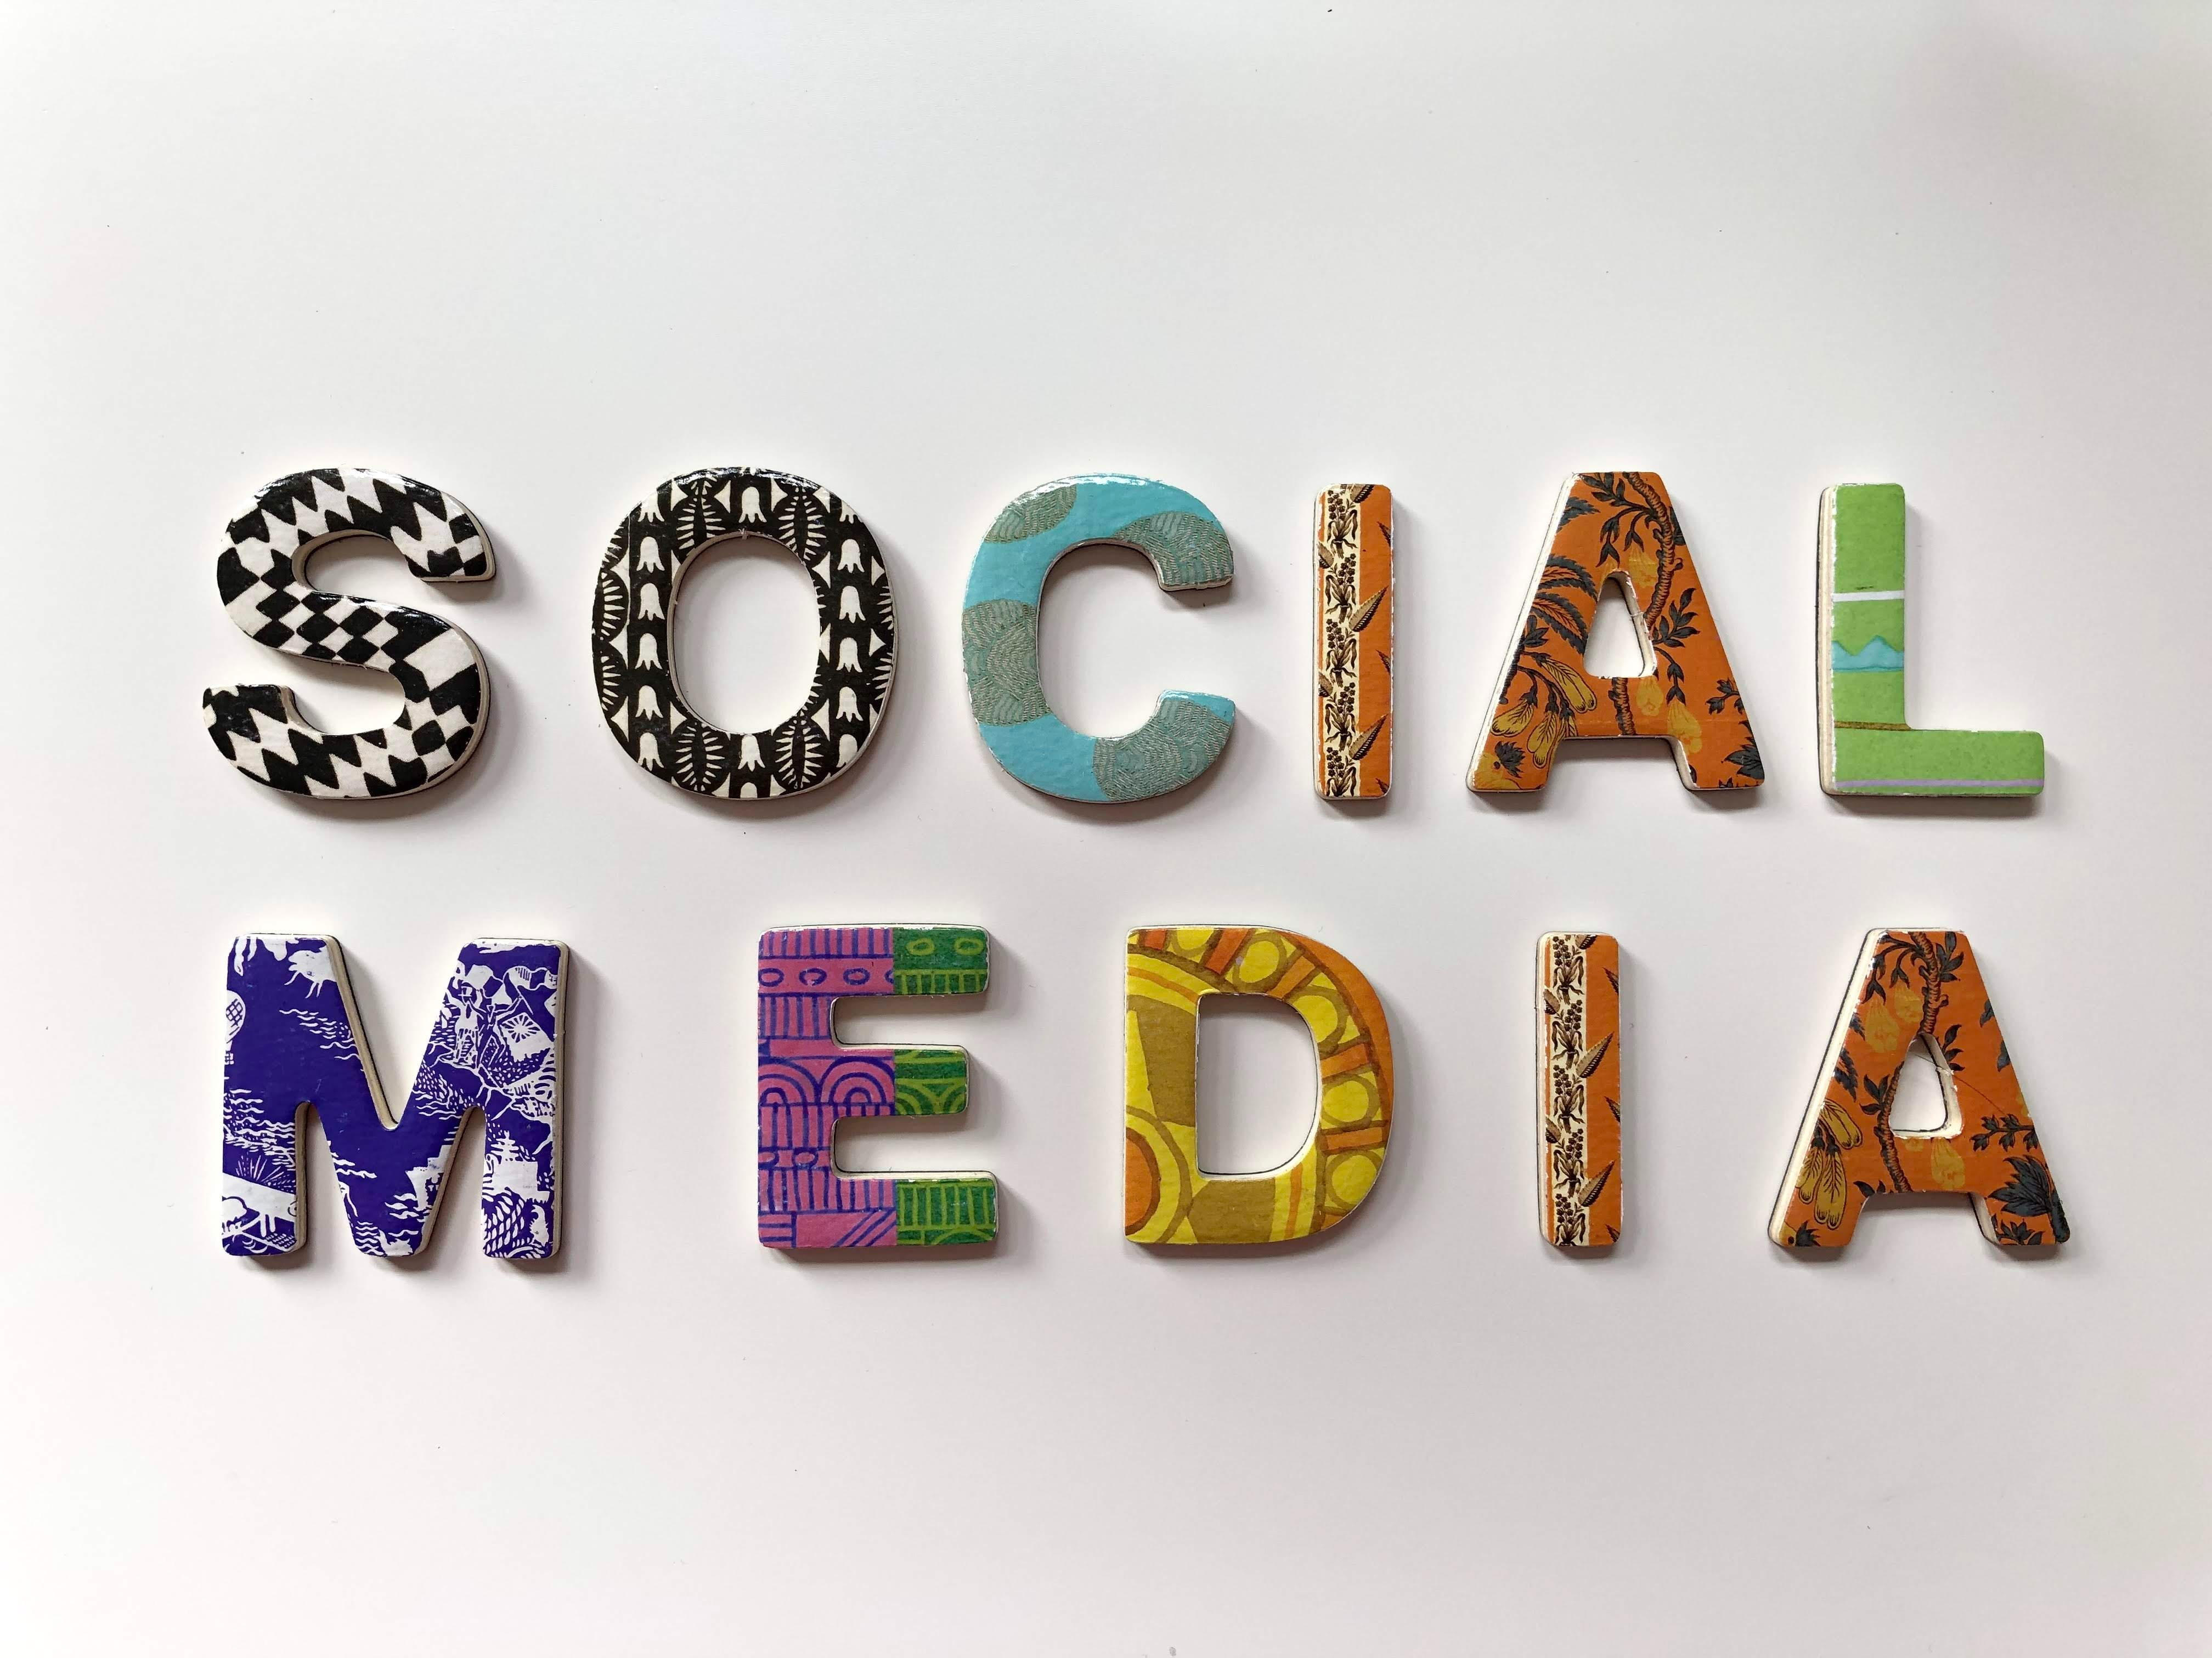

Slide 2
What is Social media?
computer-based technology
Quick electronic communication of content
largest social media networks
user-generated content
personalized profiles

Slide 3
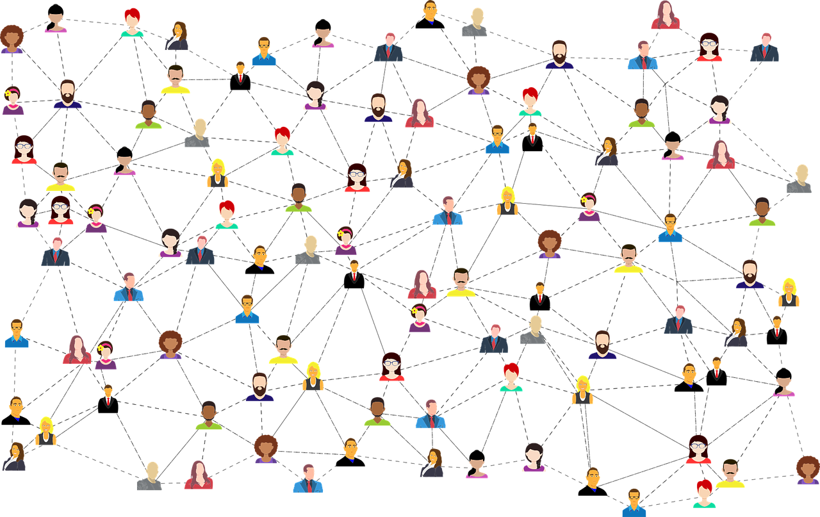
Understanding Social Media
interact

Slide 4
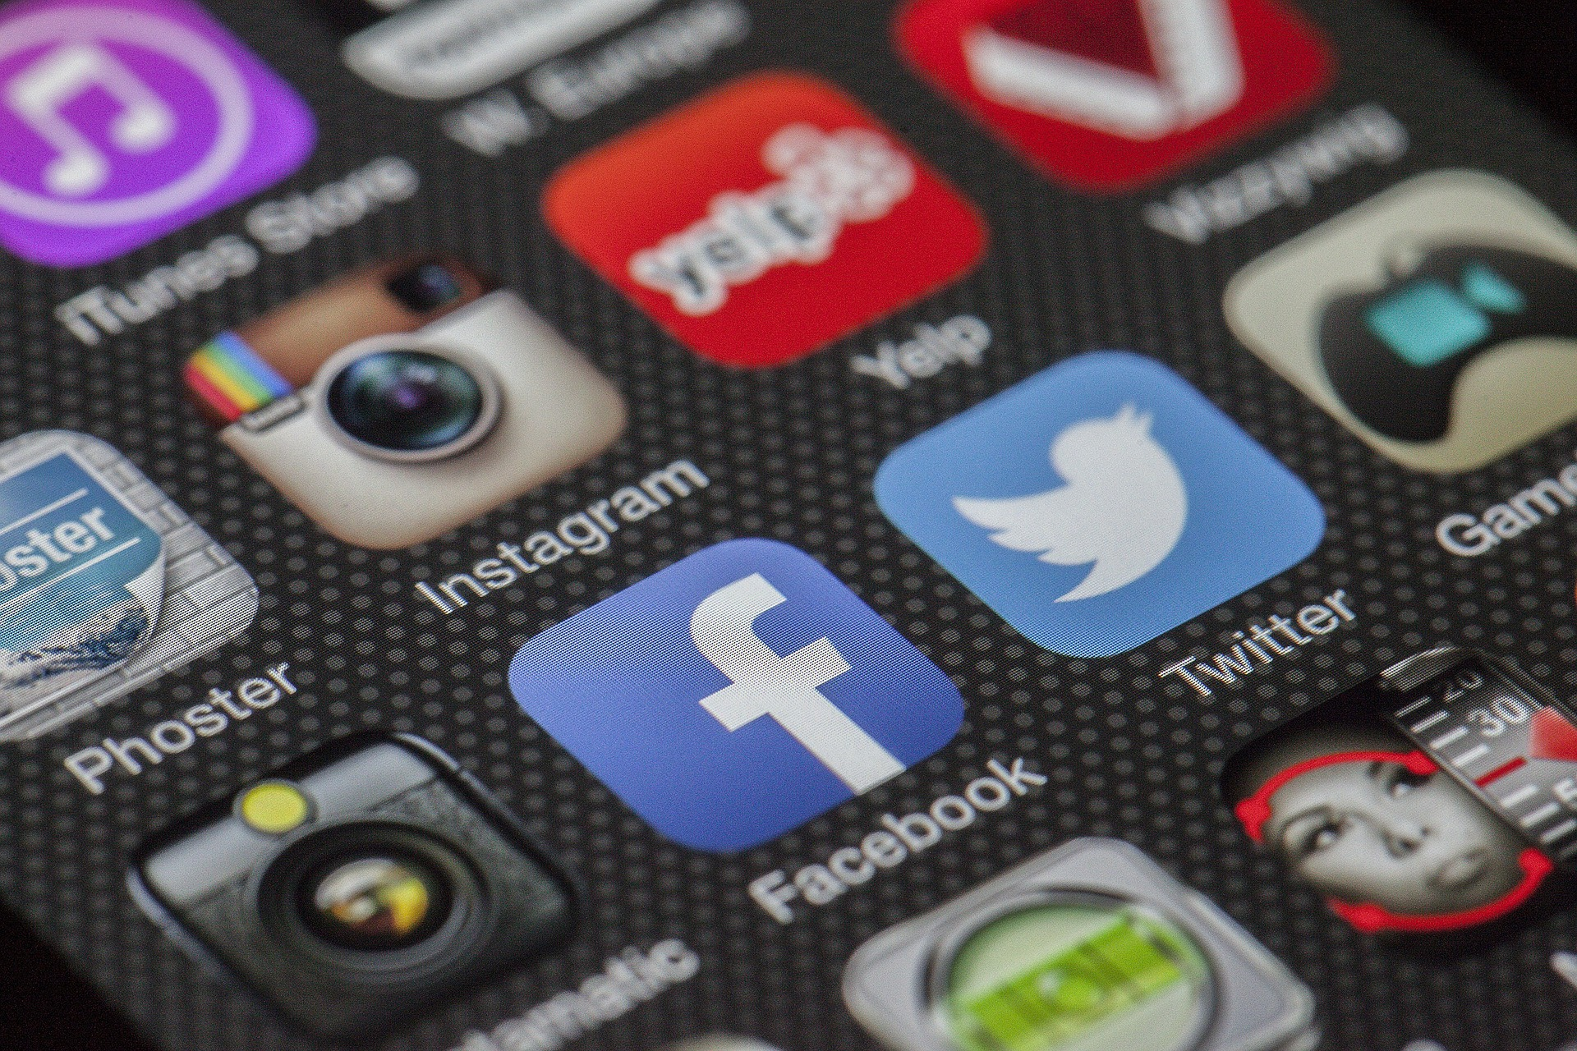



Types of Social Media
Facebook (2.74 billion users)
YouTube (2.29 billion users)
WhatsApp (2 billion users)
Facebook Messenger (1.3 billion users)
Instagram (1.22 billion users)
Whatsapp (1.21 billion users)
TikTok (689 million users)

Slide 5
Pros
Cons
Faster, Easier Communication
Networking & Partnerships
Boost Organic Visibility
Increase Website Traffic
Branding
ADDICTION
DATA BREACHES
CYBERBULLING

Slide 6
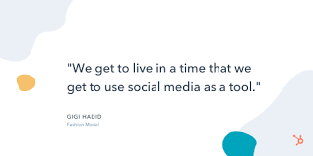
Conclusion
Social media changed our life so much
Our life became more convenient because social media is a very useful tool for us in 21st century, it could help us to improve our life.
Social media has taken world by storm, capturing more than 3.8 billion users worldwide and counting.
Allowing us to stay connected with our friends and families.
BE RESPONSIBLE WHILE USING SOCIAL MEDIA

Slide 7
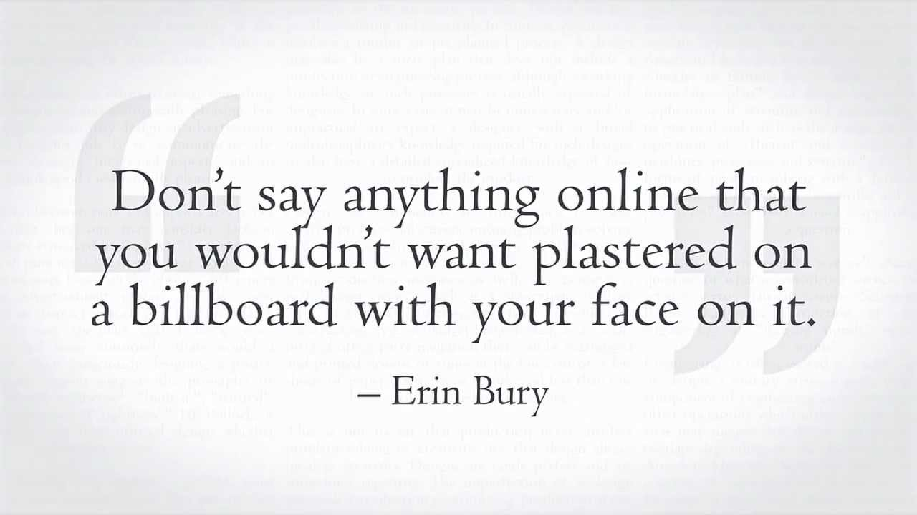

Slide 8


Slide 9
THANK YOU

